Slide 1
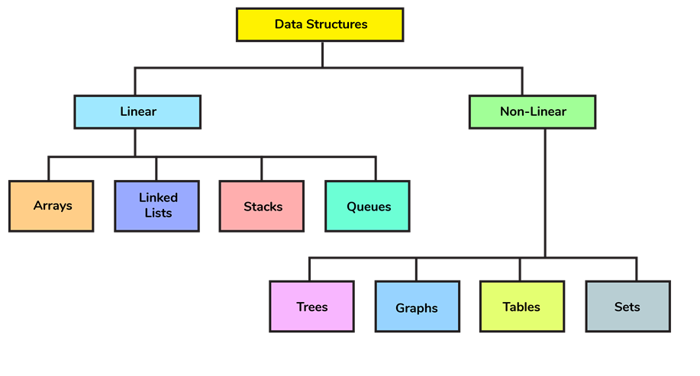
Classification of data structures

Slide 2
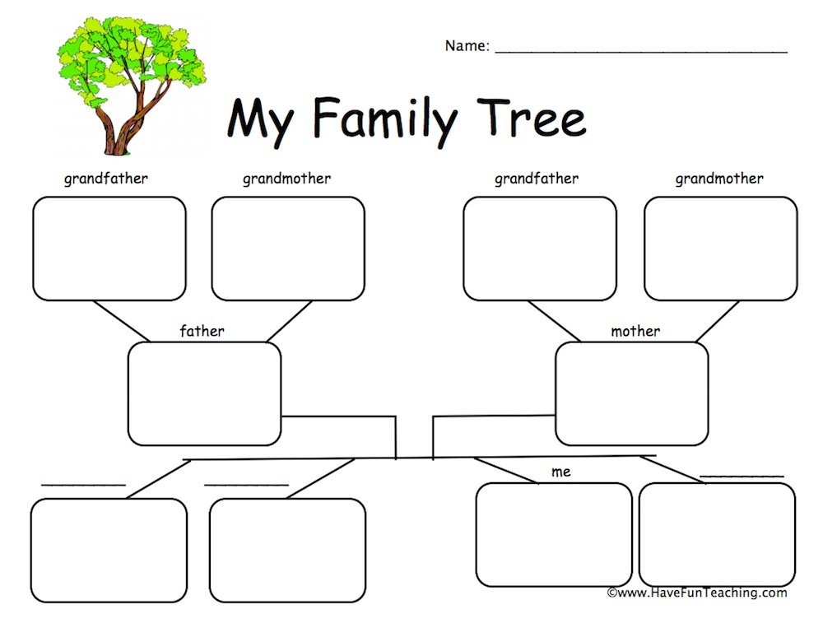

Slide 3
Tree Data Structure
A tree is a nonlinear data structure
They organize data hierarchically.
A tree can be empty with no nodes or a tree is a structure consisting of one node called the root and zero or one or more subtrees.
A tree has following general properties:
One node is distinguished as a root;
Every node (exclude a root) is connected by a directed edge

Slide 4
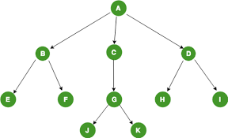
TERMINOLOGY…...
Root is the topmost node of the tree
Edge is the link between two nodes
Child is a node that has a parent node
Parent is a node that has an edge to a child node
A is a parent of B, C, D, B is called a child of A.
B is a parent of E, F

Slide 5
TERMINOLOGY…...
Number of subtrees of a node is called its degree
Degree of a tree is the maximum of the degree of the nodes in the tree
Degree of A---3
Degree of B---2
Degree of C---1

Slide 6
TERMINOLOGY…...
Nodes with no children are called leaves, or external nodes
Nodes, which are not leaves, are called internal nodes
Internal nodes have at least one child.
Nodes with the same parent are called siblings.
B,C,D are siblings

Slide 7
TERMINOLOGY…...
Level of a node: A measure of its distance from the root:
Level of the root = 1
The depth of a tree is the number of nodes from the root down to the farthest leaf node.

Slide 8
TERMINOLOGY…...
Path refers to the sequence of nodes along the edges of a tree.
The length of the path from a node to itself is 0.
There is exactly one path from the root to each node.

Slide 9
TERMINOLOGY…...
KEY is the value of the node
Traversal is the different way of visiting the nodes in the tree only once

Slide 10
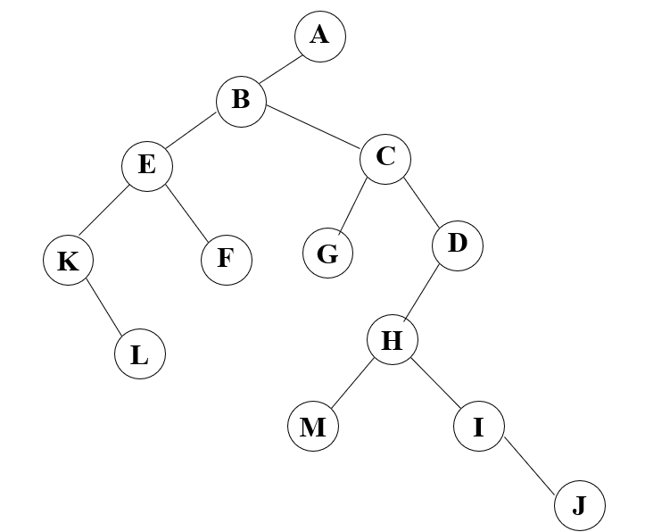
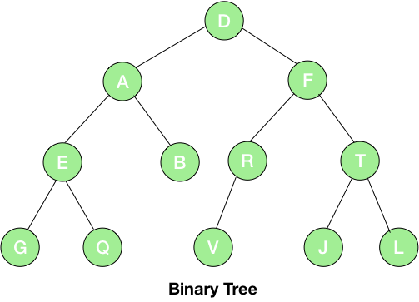
Binary trees
In computer science, a binary tree is a tree data structure in which each node has at the most two children, which are referred to as the left child and the right child

Slide 11
Applications of Binary tree
There are many other data structures that are derived from the idea of a binary tree,
binary search tree
syntax tree, heap
hash tree
red-black tree
binary tree
AVL tree.
Other real-life applications of a binary tree include
binary space partition
heap sort
Huffman coding
virtual memory management
Indexing.

Slide 12
Abstract Data Type Binary_Tree
for all bt, bt1, bt2 ∈ BinTree, item ∈ element
Bintree Create()::= creates an empty binary tree
Boolean IsEmpty(bt)::= if (bt==empty binary tree) return TRUE else return FALSE

Slide 13
Bintree Lchild(bt)::= if (IsEmpty(bt)) return error else return the left subtree of bt
element Data(bt)::= if (IsEmpty(bt)) return error else return the data in the root node of bt
Bintree Rchild(bt)::= if (IsEmpty(bt)) return error else return the right subtree of bt

Slide 14
TYPES OF BINARY TREES
SKEWED BINARY TREE
COMPLETE BINARY TREE FULL BINARY TREE
Binary Search tree
Threaded Binary tree
height Balanced tree
B tree
AVL trees

Slide 15
EXAMPLES
Skewed Binary Tree
A
1
A
B
2
B
C
3
D
4
E
5

Slide 16
Full BT
A full binary tree is a tree in which every node other than the leaves has two children.
A
B
C
D
E
F
G
H
I
J
K
L
M
N
O
Full binary tree of depth 4

Slide 17
Complete BT
A complete binary tree is a binary tree in which every level, except possibly the last, is completely filled, and all nodes are as far left as possible.
A
B
C
D
E
F
G
H
I
Complete binary tree

Slide 18
Properties of Binary tree
Maximum Number of Nodes in BT

Slide 19
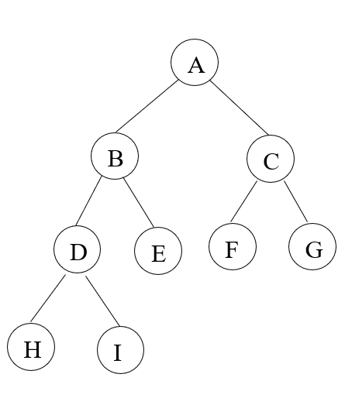
Maximum Number of Nodes in BT
The maximum number of nodes on level i of a binary tree is 2^{i-1}, i>=1.
The maximum number of nodes in a binary tree of depth k is 2^{k}-1, k>=1.

Slide 20
Relation between maximum number of nodes and depth
N= 2^{k}-1
if k=4; N= 2⁴-1 =15,
N= 2^{k}-1
N+1= 2^{k}
^{Taking log on both sides}
log (N+1)=log 2^{k}
log (N+1)=k log 2
log (N+1)=k

Slide 21
Binary Tree Representations
Sequential representation
Linked representation

Slide 22
Sequential Binary Tree Representation
If a complete binary tree with n nodes (depth = log n + 1) is represented sequentially, then for any node with index i, 1<=i<=n, we have:
parent(i) is at i/2 if i!=1. If i=1, i is at the root and has no parent.
left_child(i) ia at 2i if 2i<=n. If 2i>n, then i has no left child.
right_child(i) ia at 2i+1 if 2i +1 <=n. If 2i +1 >n, then i has no right child.

Slide 23
Sequential Representation
[1]
[2]
[3]
[4]
[5]
[6]
[7]
[8]
[9]
A
B
C
D
E
F
G
H
I
A
B
C
D
E
F
G
H
I

Slide 24
Sequential Representation
A
[1]
[2]
[3]
[4]
[5]
[6]
[7]
[8]
[9]
.
[16]
A
B
--
C
--
--
--
D
--
.
E
B
C
D
E

Slide 25
Drawbacks of Sequential Representation
(1) waste space
(2) issues with respect to insertion/deletion

Slide 26
Linked Representation
struct node
{
int data;
struct node *left;
struct node *right;
};
data
left_child
data
right_child
left_child
right_child

Slide 27
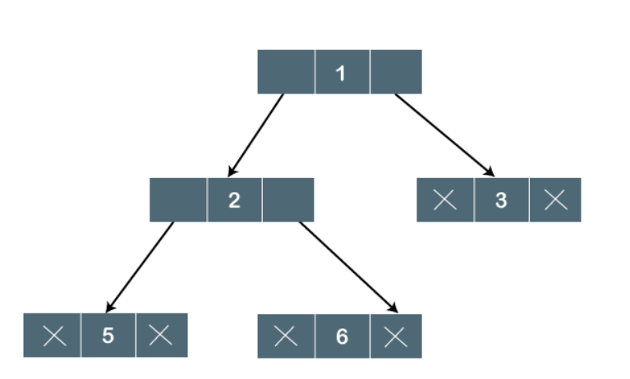

Slide 28
struct node* newNode(int data)
{
struct node* node = (struct node*) malloc (sizeof(struct node));
node->data = data;
node->left = NULL;
node->right = NULL;
return(node);
}
main()
{
struct node *root = newNode(1);
root->left = newNode(2);
root->right = newNode(3);
root->left->left = newNode(4);
}
struct node
{
int data;
struct node *left;
struct node *right;
};

Slide 29
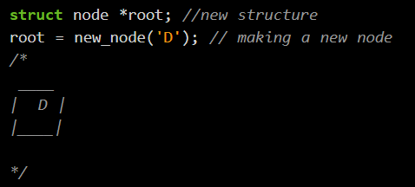
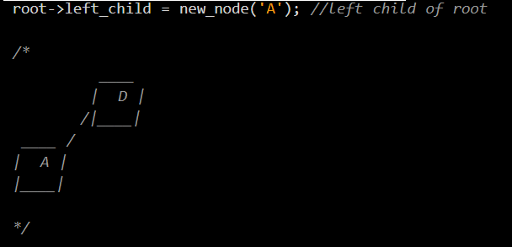

Slide 30
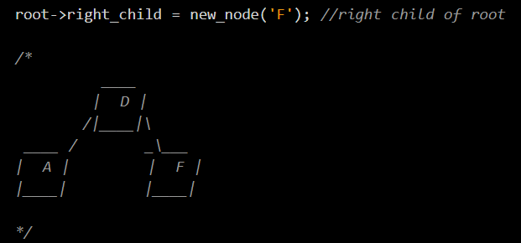

Slide 31
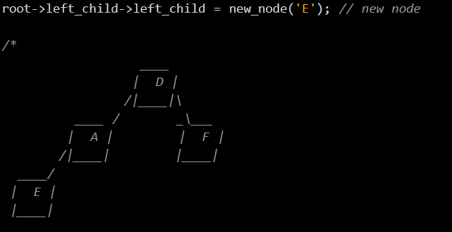

Slide 32
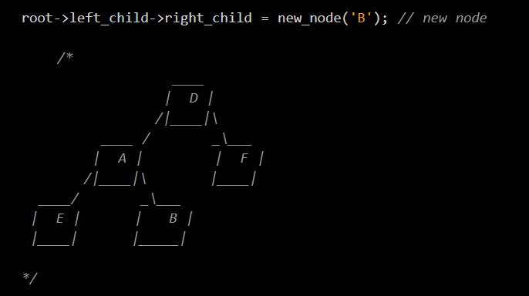

Slide 33
DEMO
EXAMPLES
SIMPLE BINARY TREE
BINARY TREE WITH MULTIPLE NODES

Slide 34
Binary Tree Traversals
Let L, V, and R stand for moving left, visiting the node, and moving right.
There are six possible combinations of traversal
LVR, LRV, VLR, VRL, RVL, RLV
Adopt convention that we traverse left before right, only 3 traversals remain
LVR, LRV, VLR
inorder, postorder, preorder

Slide 35
Arithmetic Expression Using BT
+
inorder traversal
A / B * C * D + E
infix expression
preorder traversal
+ * * / A B C D E
prefix expression
postorder traversal
A B / C * D * E +
postfix expression
*
E
*
D
/
C
A
B

Slide 36
Inorder Traversal (recursive version)
void inorder(tree_pointer ptr)
/* inorder tree traversal */
{
if (ptr) {
inorder(ptr->left_child);
printf(“%d”, ptr->data);
indorder(ptr->right_child);
}
}

Slide 37
Preorder Traversal (recursive version)
void preorder(tree_pointer ptr)
/* preorder tree traversal */
{
if (ptr) {
printf(“%d”, ptr->data);
preorder(ptr->left_child);
preorder(ptr->right_child);
}
}

Slide 38
Postorder Traversal (recursive version)
void postorder(tree_pointer ptr)
/* postorder tree traversal */
{
if (ptr) {
postorder(ptr->left_child);
postorder(ptr->right_child);
printf(“%d”, ptr->data);
}
}

Slide 39
Binary Search Tree
A Binary Search Tree (BST) is a binary tree in which
The left sub-tree of a node has a key less than its parent node's key.
The right sub-tree of a node has a key greater than to its parent node's key.

Slide 40
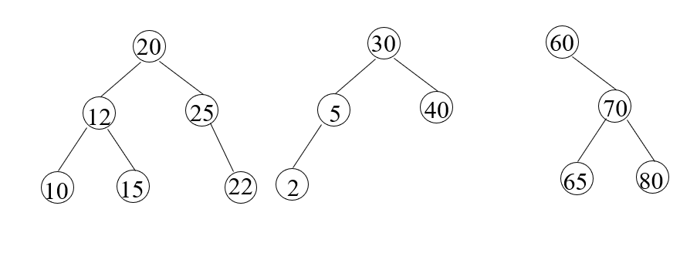
Examples of Binary search tree

Slide 41
Binary search tree operations
Insert – inserts a new node into the tree
Delete – removes an existing node from the tree
Traverse – traverse the tree in pre-order, in-order and post-order.
Search – search for a given node’s key in the tree

Slide 42
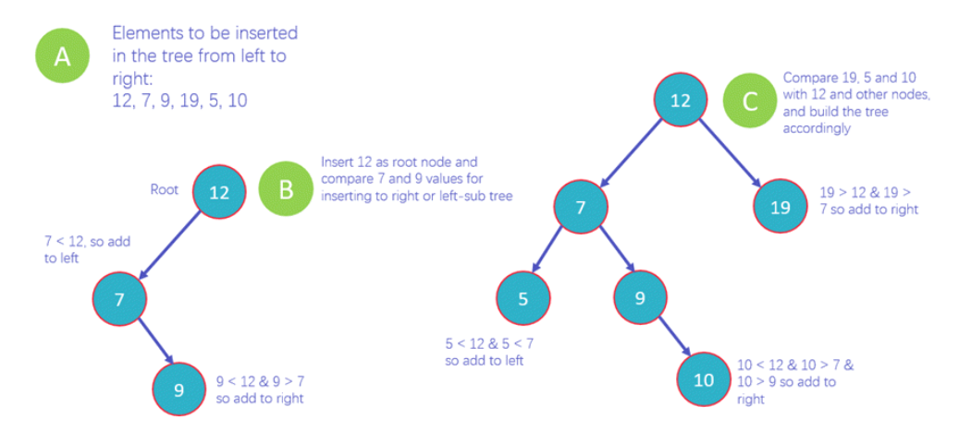
INSERT

Slide 43
Example
BINARY SEARCH TREE
27, 14, 35, 10, 19, 31, 42

Slide 44
try it out
Draw a Binary search tree for following data items:::
11, 6, 8, 19, 4 , 10, 5, 17,43, 49,31

Slide 45
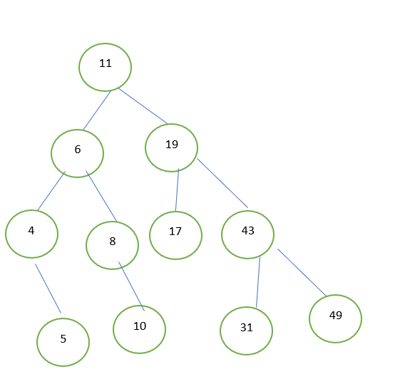

Slide 46
Insertion
Step 1 - Create a newNode with given value and set its left and right to NULL.
Step 2 - Check whether tree is Empty.
Step 3 - If the tree is Empty, then set root to newNode.
Step 4 - If the tree is Not Empty, then check whether the value of newNode is smaller or larger than the node (here it is root node).
Step 5 - If newNode is smaller than the node then move to its left child. If newNode is larger than the node then move to its right child.
Step 6- Repeat the above steps until we reach to the leaf node (i.e., reaches to NULL).
Step 7 - After reaching the leaf node, insert the newNode as left child if the newNode is smaller or equal to that leaf node or else insert it as right child.

Slide 47
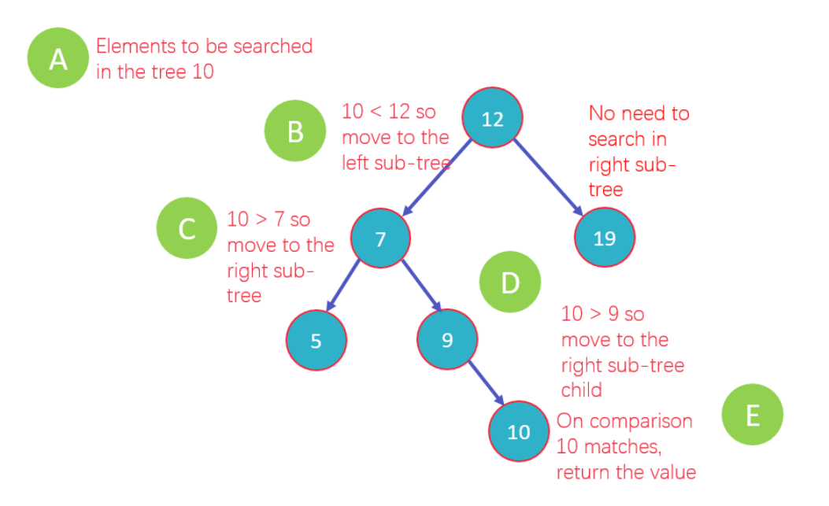
Search

Slide 48
demo

Slide 49
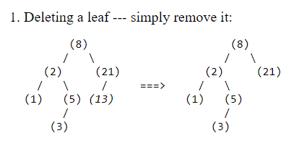
DELETION---CASE—1 –LEAF NODE
To delete 13

Slide 50
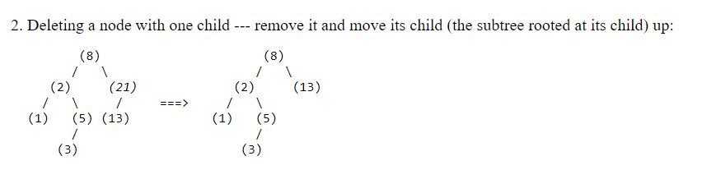
DELETION---CASE—2 –NODE with one child
To delete 21

Slide 51
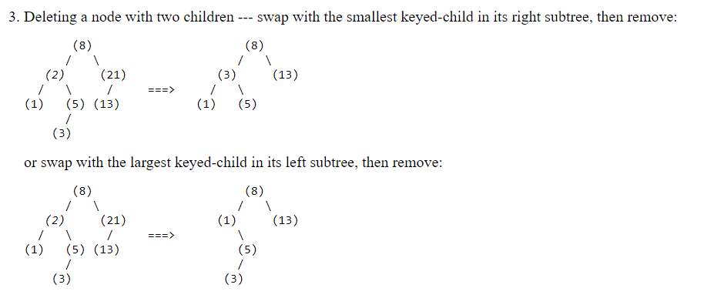
DELETION---CASE—3 –NODE with 2 children
To delete 2

Slide 52
Height of the Binary search tree
maxDepth()
1. If tree is empty then return 0
2. Else
(a) Get the max depth of left subtree recursively i.e.,
call maxDepth( tree->left-subtree)
(b) Get the max depth of right subtree recursively i.e.,
call maxDepth( tree->right-subtree)
(c) Get the max of max depths of left and right
subtrees and add 1 to it for the current node.
max_depth = max(max dept of left subtree,
max depth of right subtree) + 1
(d) Return max_depth

Slide 53
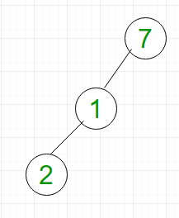
Complexity analysis BT
Searching: For searching element 2, we have to traverse all elements (assuming we do breadth first traversal). Therefore, searching in binary tree has worst case complexity of O(n).
Insertion: For inserting element as left child of 2, we have to traverse all elements. Therefore, insertion in binary tree has worst case complexity of O(n).
Deletion: For deletion of element 2, we have to traverse all elements to find 2 (assuming we do breadth first traversal). Therefore, deletion in binary tree has worst case complexity of O(n).

Slide 54
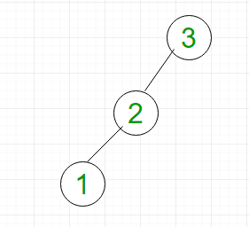
Complexity analysis BST
Searching: For searching element 1, we have to traverse all elements (in order 3, 2, 1). Therefore, searching in binary search tree has worst case complexity of O(n). In general, time complexity is O(h) where h is height of BST.
Insertion: For inserting element 0, it must be inserted as left child of 1. Therefore, we need to traverse all elements (in order 3, 2, 1) to insert 0 which has worst case complexity of O(n). In general, time complexity is O(h).
Deletion: For deletion of element 1, we have to traverse all elements to find 1 (in order 3, 2, 1). Therefore, deletion in binary tree has worst case complexity of O(n). In general, time complexity is O(h).

Slide 55
Complexity ideas------Create and perform traversal in binary search tree
check for the worst case ie. skewed tree if the data is ordered
compare binary tree to binary search tree in terms of depth or search

